Slide 1



PipDynamics
An AI-Based Forex Market Analysis & Trading Recommendation System
Team Members: Arun Maniyan S, Murugan M, Kajenthiran K
Guide: Mrs. M. R. Geetha, Assistant Professor,Department of AI & Data Science
Notes:
1

Slide 2

The Forex Trading Challenge
The foreign exchange market is the world's largest financial market, with over $7 trillion in daily trading volume. Currency prices fluctuate rapidly and unpredictably, creating an environment where manual traders struggle to keep pace.
Emotional decision-making and delayed reactions lead to costly mistakes and missed opportunities. Traditional approaches simply can't process the massive volumes of data required to identify profitable patterns.
AI offers a transformative solution: scalable, data-driven analysis that navigates market complexity with speed and precision that human traders cannot match.
Notes:
2

Slide 3
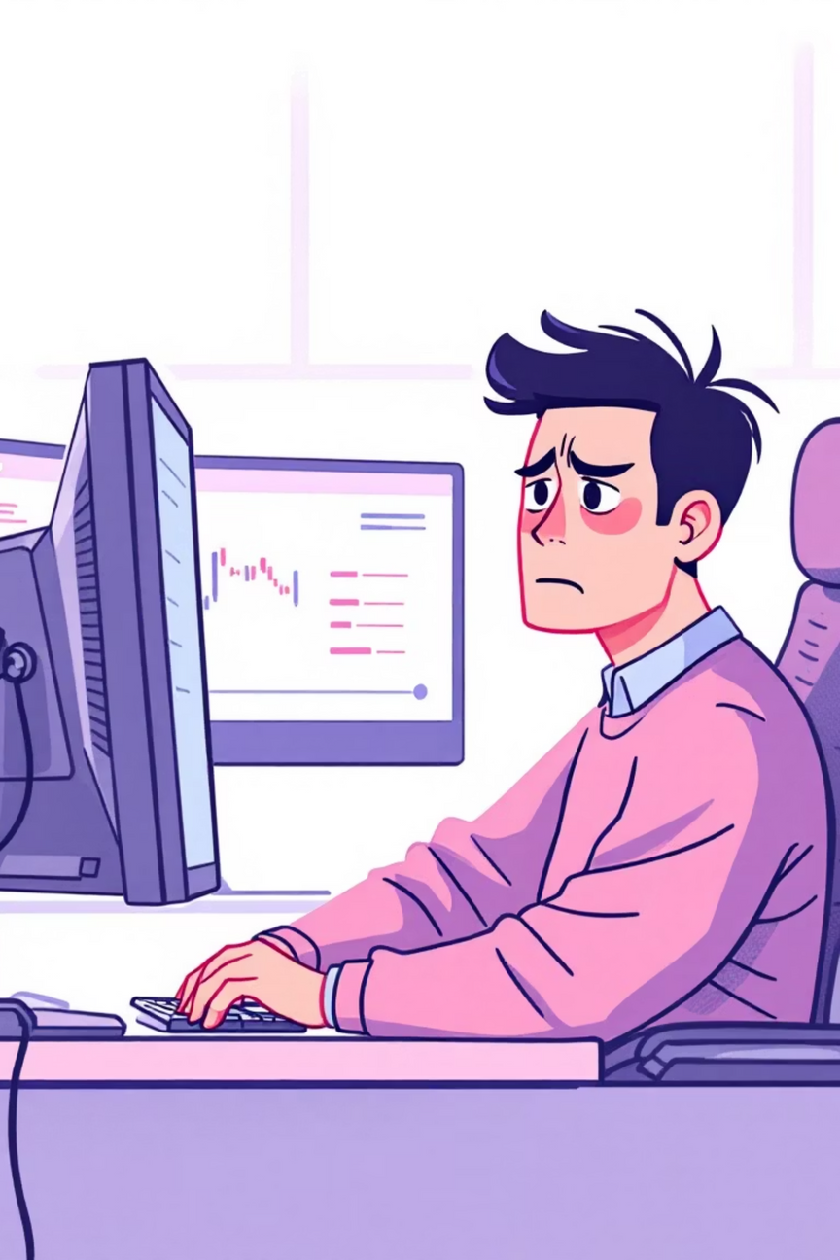




Why Current Systems Fall Short
Manual Analysis
Heavy reliance on fixed technical indicators and manual chart reading that can't adapt to changing market conditions
Human Limitations
Cognitive bias and slow reaction times prevent traders from responding effectively in volatile, fast-moving markets
Low Accuracy
Traditional forecasting methods deliver inconsistent results and high risk of significant financial losses
Lack of Intelligence
Existing tools lack adaptive learning capabilities and intelligent pattern recognition essential for modern trading
Notes:
3

Slide 4





Introducing PipDynamics
Your AI-Powered Forex Trading Assistant
Advanced ML Models
Leverages cutting-edge algorithms including LSTM neural networks and Random Forest ensembles
Pattern Detection
Analyzes vast historical forex datasets to identify meaningful trends and market signals
Attention Mechanisms
Filters market noise using attention-based architectures inspired by latest research
Actionable Signals
Delivers clear Buy, Sell, or Hold recommendations to optimize timing and reduce risk
Result: Faster decisions, reduced emotional bias, and data-driven trading confidence
Notes:
4

Slide 5

Project Objectives
1
Harness AI for Market Analysis
Deploy machine learning to analyze and predict forex market trends with unprecedented accuracy
2
Automate Trading Recommendations
Deliver intelligent, automated signals that guide traders toward optimal entry and exit points
3
Enhance Decision-Making
Reduce emotional bias and improve trader confidence through objective, data-backed insights
4
Enable Rapid Response
Process market changes in real-time, allowing traders to react faster than ever before
Notes:
5

Slide 6
Methodology Overview
01
02
03
Data Collection
Data Preprocessing
Feature Extraction
Gather comprehensive historical and real-time forex data from multiple reliable sources
Clean and normalize data, removing noise, outliers, and inconsistencies to ensure quality inputs
Engineer relevant features that capture temporal patterns, market dynamics, and cross-currency relationships
04
05
Model Training
Prediction & Signals
Train attention-based LSTM networks and ensemble methods on prepared datasets to learn complex patterns
Generate accurate price movement forecasts and translate them into actionable Buy/Sell/Hold recommendations
Notes:
6

Slide 7

Tools & Technologies
Python Programming
Essential Libraries
Deep Learning Frameworks
Development Environment
Core development language enabling rapid prototyping and extensive ML library support
NumPy for numerical computing, Pandas for data manipulation, Scikit-learn for ML algorithms
TensorFlow and Keras for building and training LSTM neural networks with attention mechanisms
Jupyter Notebook for interactive development, experimentation, and visualization
Future Integration: Real-time data feeds, automated execution platforms, and continuous model updating capabilities
Notes:
7

Slide 8

Expected Impact & Future Vision
24/7
85%+
70%
Automated Trading Assistance
Prediction Accuracy
Risk Reduction
Continuous monitoring and signal generation without human fatigue or emotional interference
Performance comparable to professional traders, validated by recent machine learning research
Significant decrease in emotional trading errors and improved timing of market entries and exits
Applications & Next Steps
Who Benefits?
Future Roadmap
Individual forex traders seeking competitive advantage
Real-time deployment with live market integration
Financial analysts requiring rapid market insights
Continuous learning from new market data
Trading platforms integrating AI-powered features
Expansion to additional currency pairs and assets
Institutional investors optimizing currency portfolios
Mobile app development for on-the-go trading
PipDynamics: Empowering smarter, faster forex trading decisions through artificial intelligence
Notes:
8

